Slide 1

Rational and Conscious
The World of “ Happy ”
Customer Experience

Slide 2
Rational and Conscious
Myth

Slide 3

Customer Service or CRM
Customer Experience

Slide 4
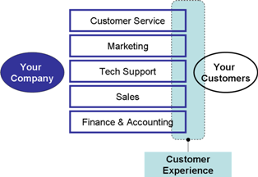

Slide 5
Rational and Conscious
Why

Slide 6
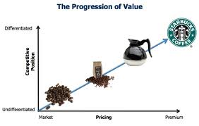

Slide 7
Rational and Conscious
What is Customer Experience?
A Customer Experience is an interaction between an organization and a customer as perceived through a customers’ conscious and subconscious mind.

Slide 8
Rational and Conscious
Beyond Philosophy
Credence - Capability - Context

Slide 9

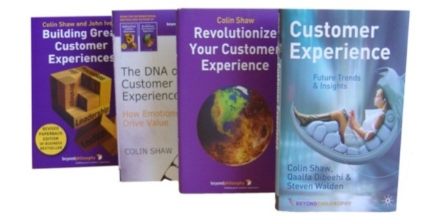
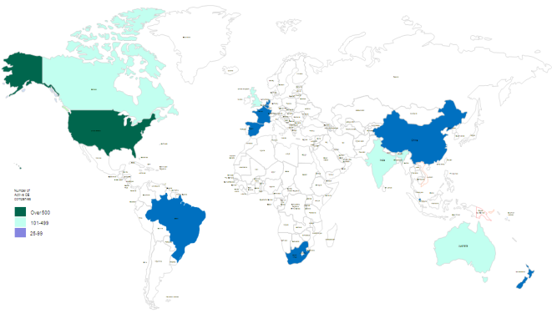

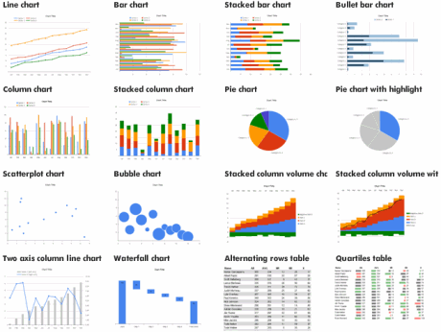

We are Customer Experience Thought-Leaders
Customer Experience is all we do.. Since 2002!
Customer Experience is all we do!
Thought leadership is our differentiator. We have written 4 books
We work globally with offices in London and North America; with associate experience in Middle East, Africa & Asia
We maintain links with academia to keep us ahead of the latest trends
We are an evidence based consultancy

Slide 10



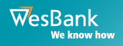


























We have an extensive track record in Telecommunications

Slide 11
How we engage:
Naive to Natural Assessment
Emotional Signature ®
Customer Experience Statement & Pyramid
Journey Mapping
Total Transformation

Slide 12
Naive to Natural Assessment

Slide 13

Naïve to Natural (N2N) Model – Experience Metamorphosis
The Naïve to Natural Model describes the journey organisations follow as they focus on improving their customer experience.
  It characterizes an organisation’s ability to deliver a consistent, deliberate customer experience.
The N2N model has four stages: Naïve – Transactional - Enlightened – Natural.
The model has been developed and utilised over the last nine years on a global basis through our research and client work.
Organisations generally move up the model driven by one of the following factors:
  When market conditions force them (e.g., hypercompetition, regulatory changes, etc)
  Visionary leadership
Naive
Transactional
Enlightened
Natural

Slide 14
Naïve to Natural Model Characteristics
Type of company | Some characteristics | % of firms at this level of development
Naïve | Have little or no customer experience capability Product focused – price and features lead Customers asked to call on different numbers for different parts of the company Efficiency and productivity are the most important KPIs | 9%
Transactional | Have some basic customer experience capability Functionally organised but have recognised need for customer service No complete view of customers on systems Take into account customer physical expectation | 67%
Enlightened | Have some advanced customer experience capability Have appointed a Customer Experience Director or council Customer experience measures form large part of bonus Focus on stimulating planned emotions and build these into the design of the customer experience | 22%
Natural | Have highest level of customer experience capability Have an experience map Focus on depth of emotion Use theatre as a delivery method | 2%

Slide 15

Customer Experience Leaky Pipe
CUSTOMER EXPERIENCE
Expectations
Process
Channel
Leadership & Culture
Systems
People
Leadership & Culture
Measurement
Marketing & Branding
Strategy

Slide 16
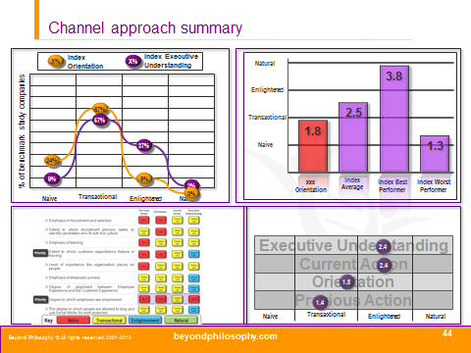
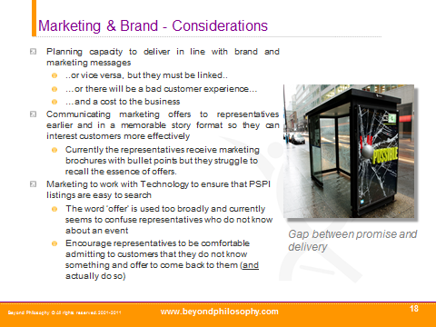
Deliverables - Naïve to Natural
Gap analysis against best performers
                Assessment of the Executive Understanding, Current Action, Current Orientation and Previous Action for each of the 9 areas
Key recommendations that will increase your capacity to deliver a consistent and engaging experience for each of the 9 areas

Slide 17
CE Metrics
Emotional Signature ®

Slide 18

Rational and Conscious
We create World Class experiences through a focus on emotion
Emotional and Subconscious

Slide 19
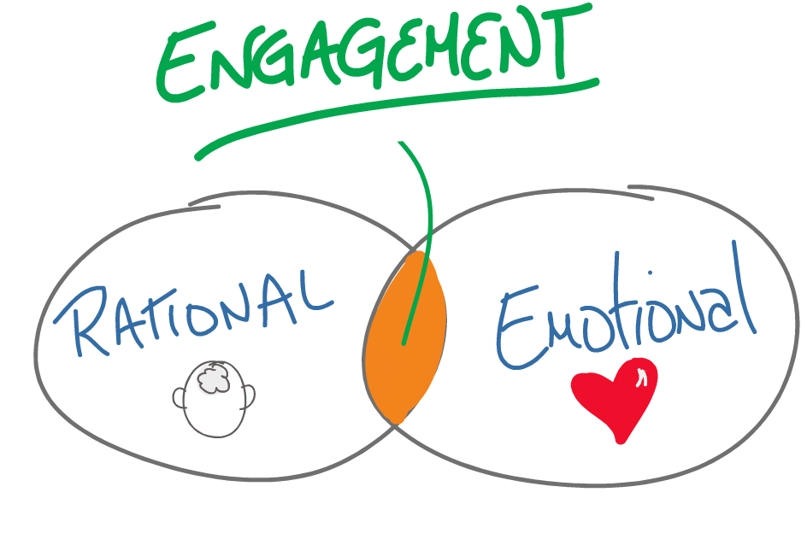
Rational and Conscious

Slide 20
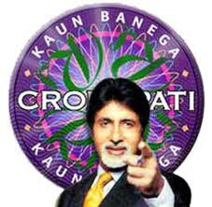
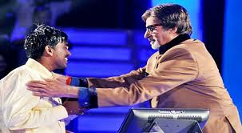
KBC 1 - Rational
KBC 5 – Rational + Emotional

Slide 21
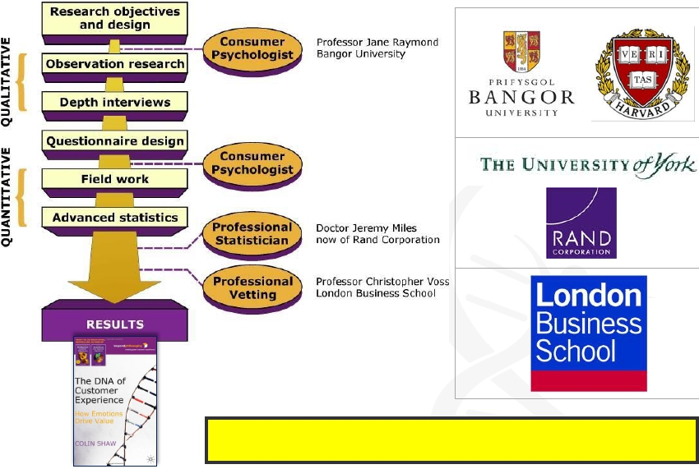
The Emotional Signature is founded on 2 years of independently validated
21
beyondphilosophy.com

Slide 22









Leading academics helped design Emotional Signature®
Professor Christopher Voss - London Business School (LBS) has guided us with his thoughts, input and validated our approach and methodology
Dr. Jeremy Miles - leading consumer Psychologist and quantitative statistician, Lecturer in Health Sciences at the University of York and now of the Rand Corporation
Professor Jane Raymond -
University of Wales, Experimental Consumer Psychology & visiting Harvard Scholar. Specializes in emotional interpretation of complex information (including brands, faces, advertisements), visual attention, and visual memory
Dr. Mark Johnson – research fellow at Cranfield School of Management. Specializes in SEM modelling and conjoint approaches

Slide 23
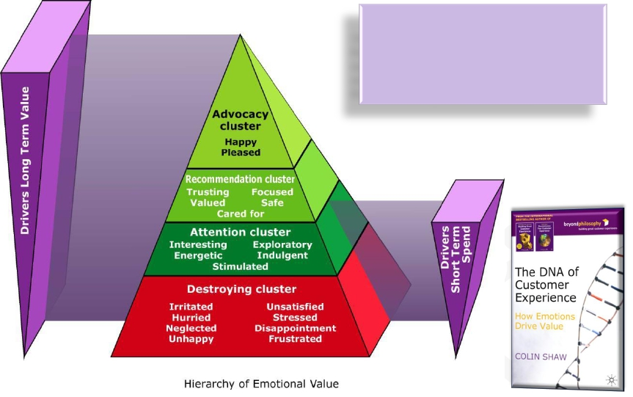
Emotional Signature®: the resulting framework
The 2 years of baseline research produced the
framework against which we will compare your
experience. The baseline model identified 20
emotions clustered into 4 hidden factors and
that drive/ destroy value for business.
beyondphilosophy.com
9

Slide 24
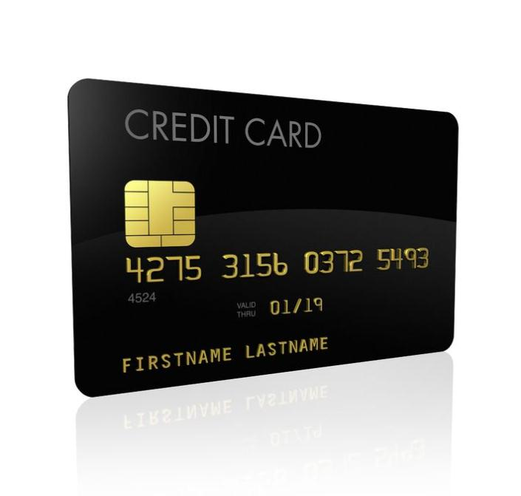
Credit card company

Slide 25
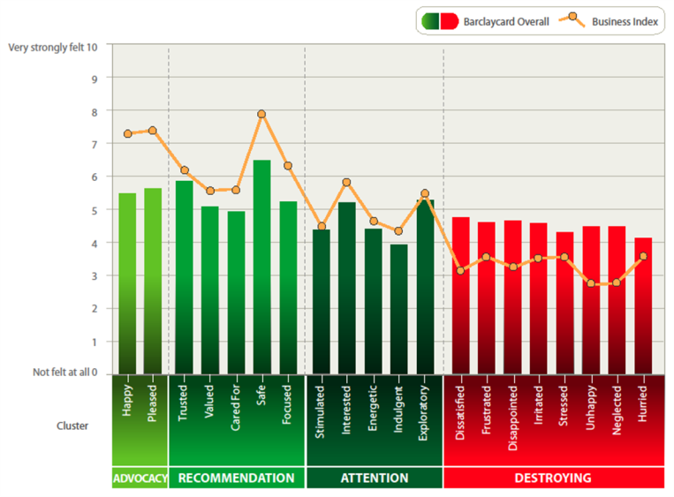
Emotional profile - the level of emotional engagement
Notes:
25

Slide 26
Credit card company example…
1
2
3
Getting a Card
Using my Card
Servicing my Account
4
5
6
Extending my Relationship
Having Financial Difficulty
Ending my Relationship

Slide 27
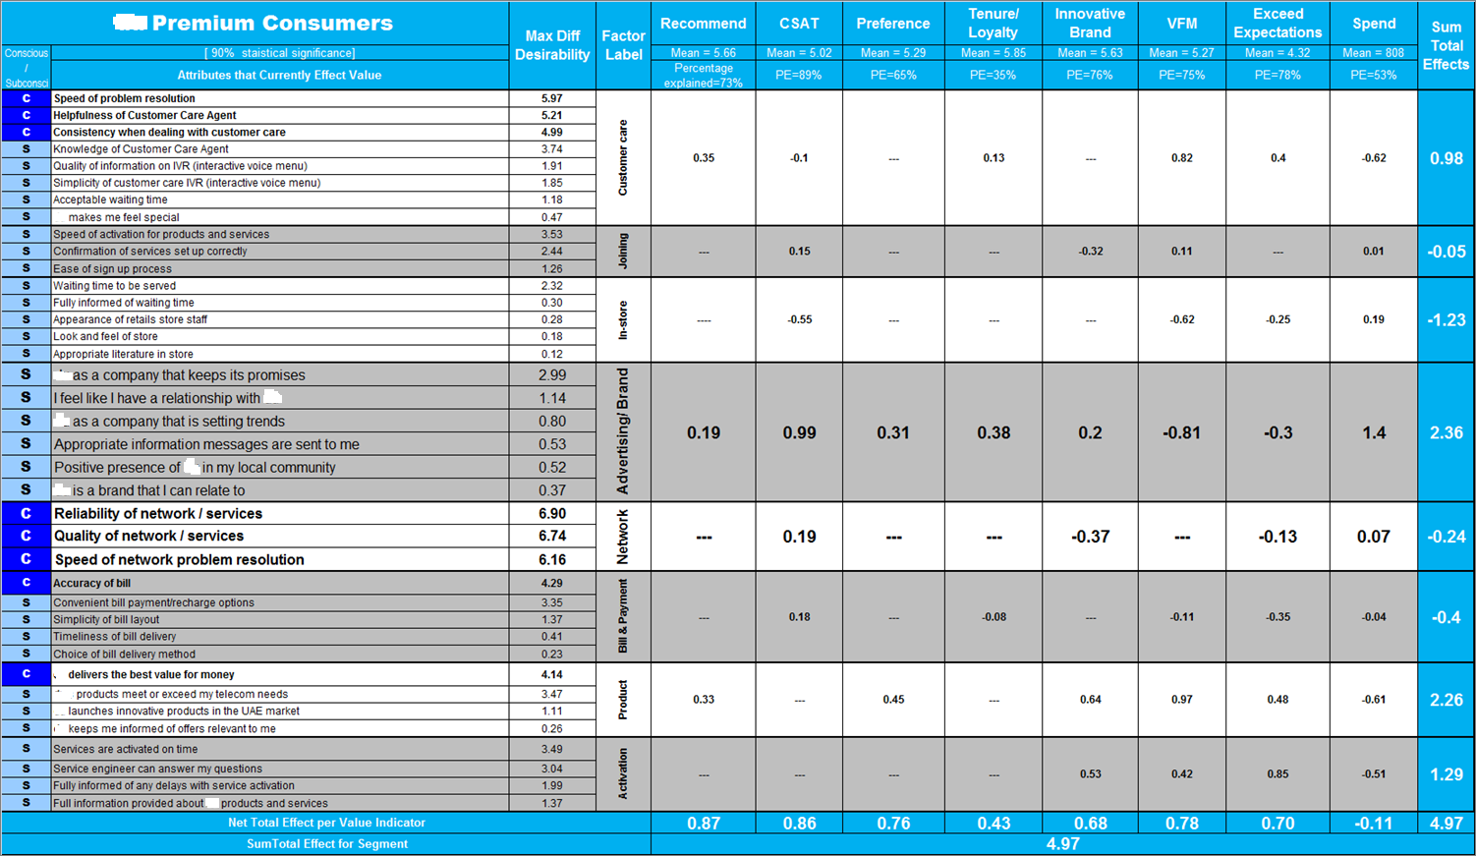
We quantify drivers and destroyers of value
0.35
-0.32
-0.55
The relative desirability of an attribute i.e. how important customers say the attribute is.
A score of 6 indicates twice as much desirability as a score of 3.
Likewise, a score of 3 indicates twice as much desirability as a score of 1.5 ..
0.99
-0.37
The magnitude of impact the factor (horizontally left) has on a specific value indicator (vertically top)
Green example: if we increase Customer Care by 1 point we would expect the Recommendation score to increase by 0.35 points. If we improve advertising/ brand by 1 point we get improvements of 0.99 on CSAT.
Red example: the joining experience ‘as it is’ destroys value i.e., by 0.32.. More of the joining experience reduces value!
0.64

Slide 28
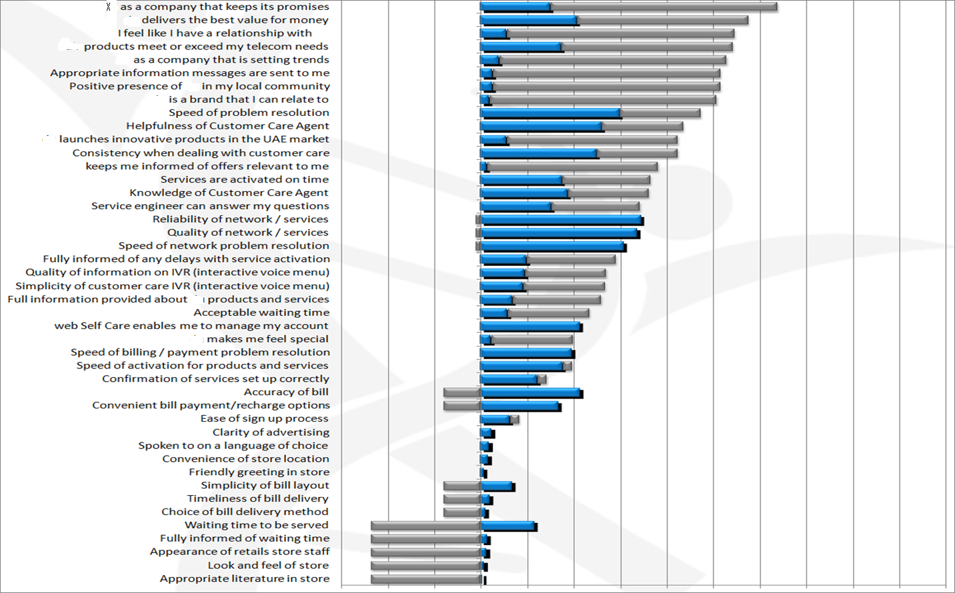
Priority Order of the Attributes (Combined desirability and current value) – Premium Consumers
Desired by Customer
Effect on Value
Top Ten
-
Relative Magnitude
+
0

Slide 29
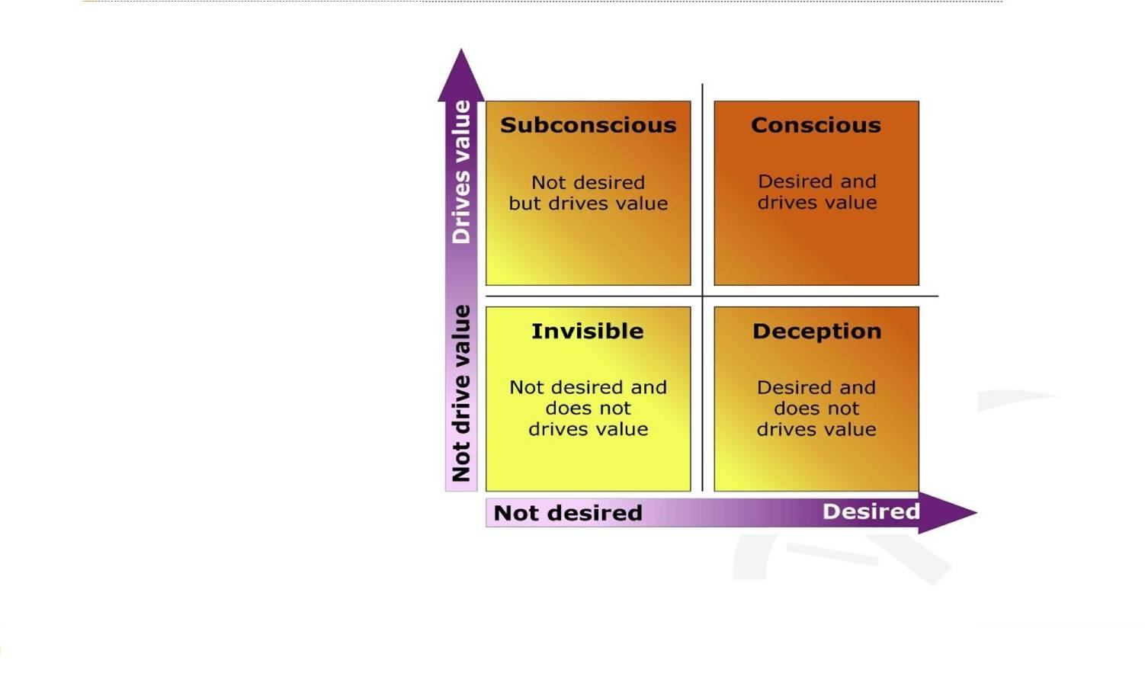
Conscious - Subconscious - Desired - Undesired
Emotional and Subconscious

Slide 30
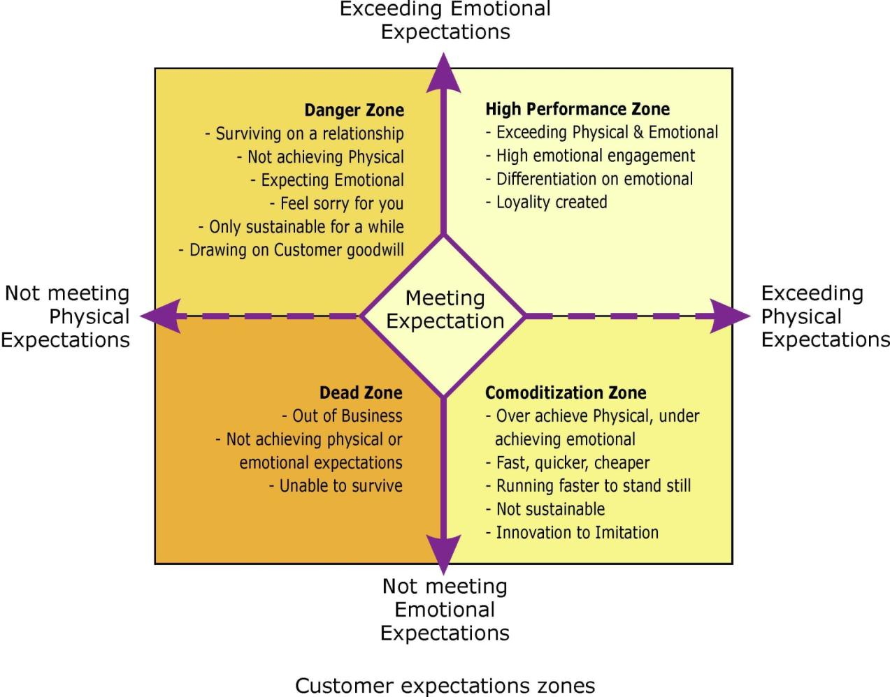

Slide 31
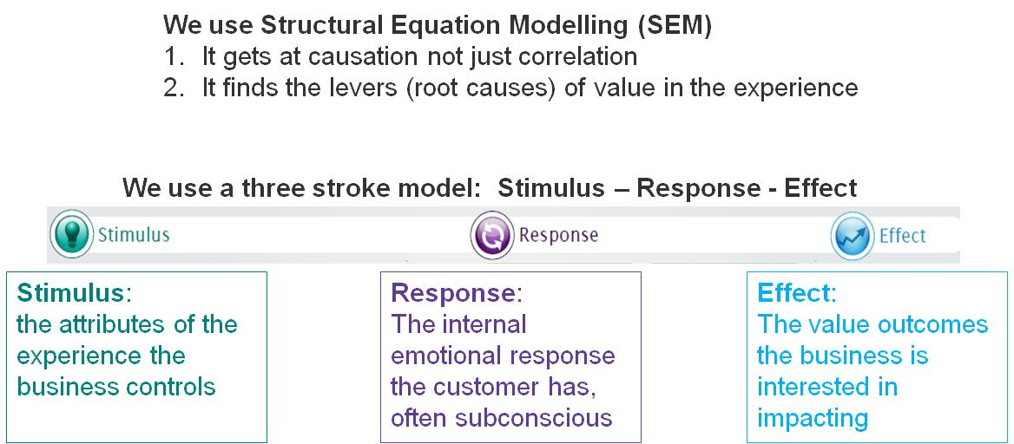
How do we find out what drives value in the experience?

Slide 32
Customer Experience Statement
& Pyramid

Slide 33
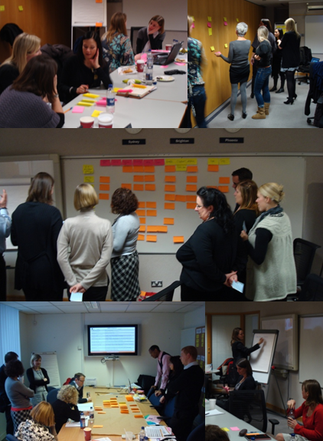
Customer Experience Statement
Spreading CE initiatives into the organisation
Aim: To use the brand statements and/ or CE input (such as the desired state experience) to define the guiding principles that sit behind the Customer Experience. These principles will guide employee behaviour.
Output: a series of statements or other expression of the CES principles to guide employee behaviour. These will also be conceptualized visually to aid communication inside the company.
Resource Requirements: a workshop with key CE stakeholders. This will use CE techniques as well as input from preceding CE research such as Emotional Signature® and Journey Mapping to derive a set of principles.

Slide 34
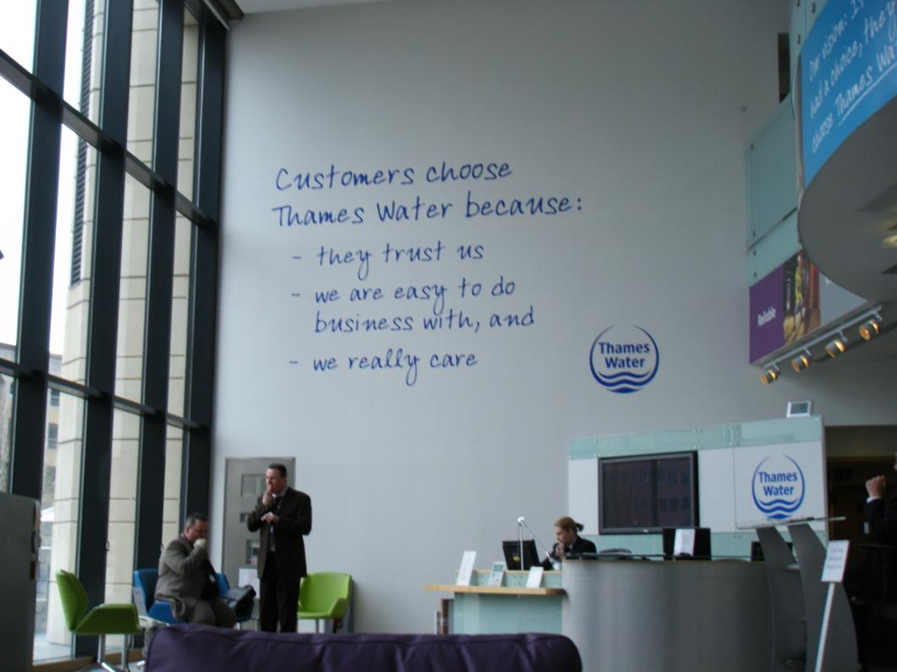
Thames Water

Slide 35

Maersk Line Customer Experience Statement
- our goal for every customer experience
Trust
Be honest, set realistic expectations, follow-up on your commitments
Cared For
Know your customer, be proactive, be adaptable
Pleased
Take ownership, show enthusiasm, do a little bit extra
Notes:
35
There are a number of key strategic questions that lead us in to our emotional values:
What is the customer experience we would like to deliver?
What are the emotions we want to evoke?
What do our customers really want?
How can we deliver a deliberate customer experience?
As a guideline for the organization to answer these questions, LMB stated that the goal for Maersk Line is to provide a customer experience that makes customers feel Pleased, Cared For, and Trust.
This is called Maersk’s Customer Experience Statement. These three emotional values describe what we want our customers to experience when being in contact with us. This is Our Goal for Every Customer Experience.
Implementing these goals in an organization of Maersk’s size, requires a lot of commitment and focus. This is why we have decided upon an implementation plan driven by Customer Experience Ambassadors in each local site.

Slide 36
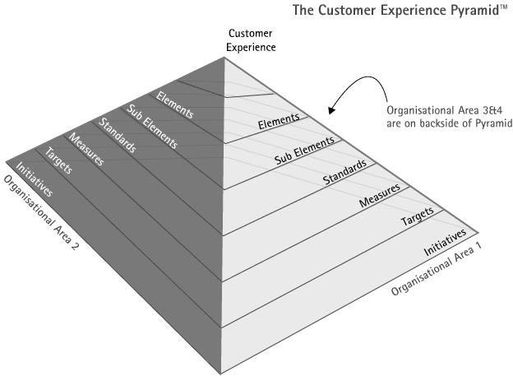
Pyramid
Spreading CE initiatives at the departmental level
Aim: to translate the Customer Experience Statement into actionable and measureable initiatives.
Output: actionable and measurable CES initiatives designed from the ‘ground-up’ (e.g., by departments); being defined at a department level also helps achieve buy-in to any CE programme.
Resource Requirements: a set of workshops involving key stakeholders in departments/ programmes within X where an experience change is required.

Slide 37
Journey Mapping

Slide 38

Rational and Conscious

Slide 39
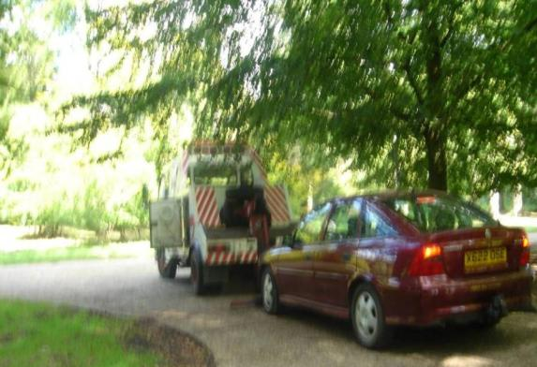
Journey Mapping
Step 1: Walking the experience of being a customer (customer mirror)
Aim: to walk the experience of being a customer as far as possible over the defined experiences as well as conduct depth interviews (or in Experience Wall) using CE journey techniques / Experience Psychology checklist.
Output: completed interviews and completion of associated Mirror activity (walk the experience).
Resource Requirements: Beyond Philosophy require X to set up the customer interviews and any scenario set-up required for consultants to act the part of a customer .

Slide 40
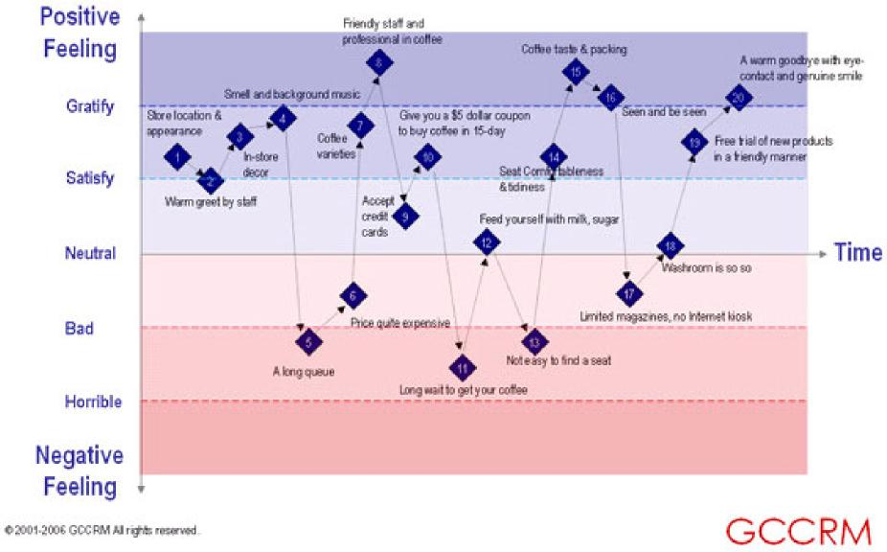
Rational and Conscious
Starbucks Customer Experience Journey Map
Emotional and Subconscious

Slide 41
Understanding the Customers Emotional Journey using Moment Mapping®
+
Hurried
Frustrated
Exceeding
emotional
expectations
CP
CP
Stressed
+
Enter
the
Resort
EC
Helped
with
bags
DVD
Not
working
EC
Visit
the
pool
Wait
Reception
They
fix
it
Welcome
Wait
EC
CP
Safe
Valued
Cared for
Failing
emotional
expectations
CP
EC
Trust
_
Irritated
Emotional Events
EC
- Emotional Cookie
CP
- Combustion Point

Slide 42
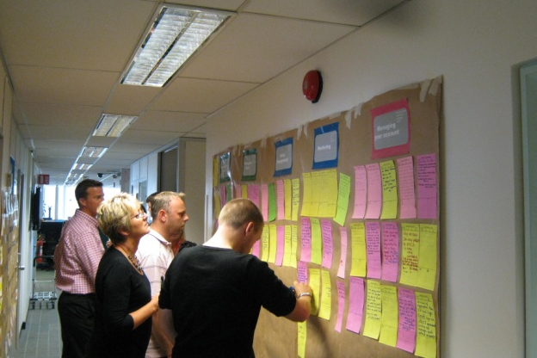
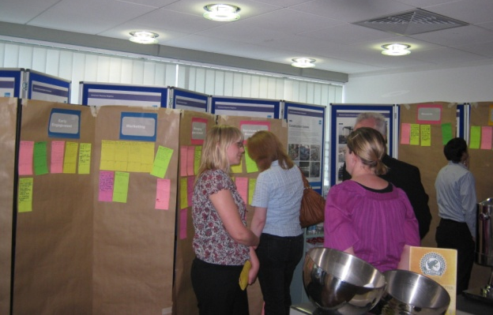
Journey Mapping
Step 3: Defining the ‘To Be’ experience
Aim: to define from the scenarios presented (and justified) the best ‘to be’ scenario. This includes identification of the key areas of activity to improve and a view of the internal requirements to execute the CE change.
Output: a story of the new ‘to be’ customer experience with defined action points.
Resource Requirements: an internal Beyond Philosophy Blue Sky workshop, then a one day workshop in which key stakeholders (normally between 5 and 15) are required to decide the final desired to be customer story/s.

Slide 43
Rational and Conscious
Money

Slide 44
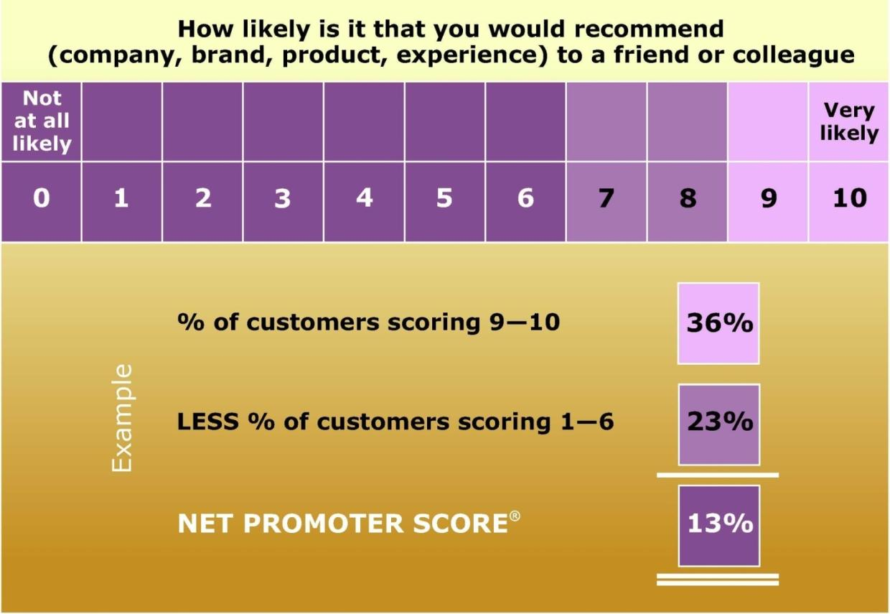
Measuring Net Promoter Score
(=promoters)
(=detractors)

Slide 45
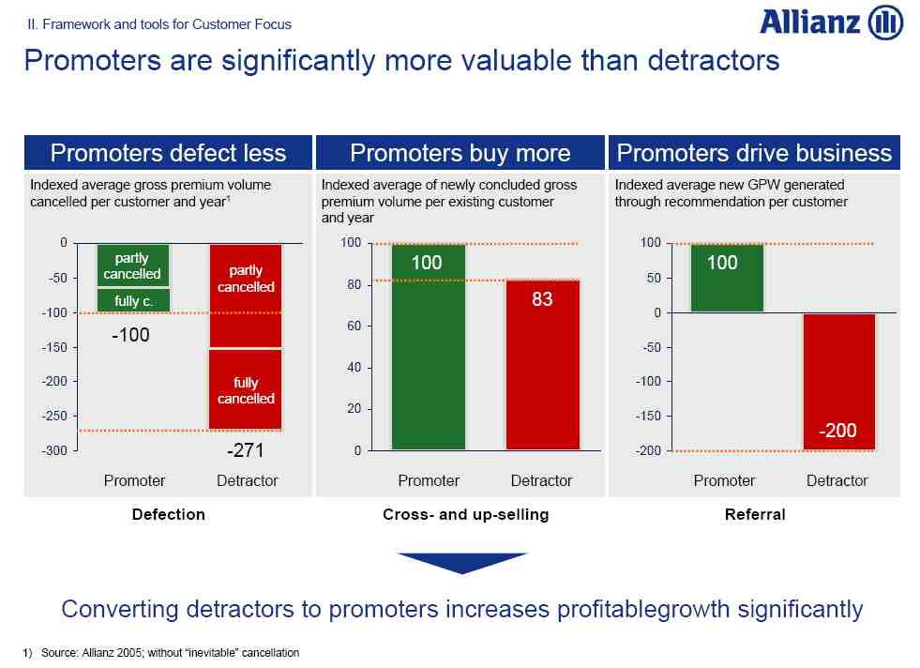

Slide 46
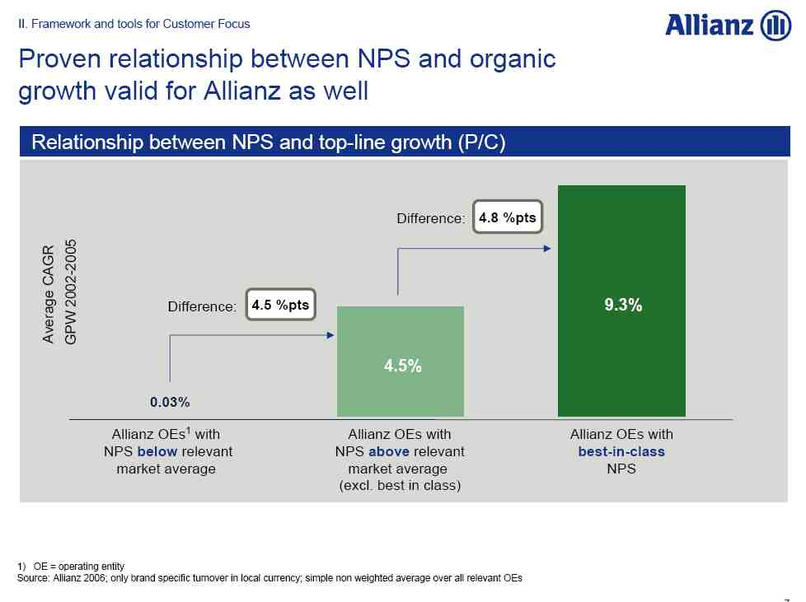

Slide 47
Rational and Conscious
Financial Returns of CE Initiatives ?
Cumulative Return of S & P Index during 2007-2011 was Minus 1.30%
Cumulative Stock Price Return of Top 10 CE leaders in S & P 500 during 2007-2011 was Plus 22.50%
Cumulative Return of CE laggards during 2007-2011 was Minus 46.30%
Source: Forrester Survey y of CE Companies and Water Remarks Consulting

Slide 48
Business Impact of Better Customer Experience Report 2011 by Rightnow
86% pays upto 25% more for better customer experience
Only 1% feel that their expectations on customer experience are always met
After negative experiences, little more than 25% posted the same on FB or Twitter

Slide 49
Rational and Conscious
Financial Returns of CE Initiatives ?
Repeat i.e. Loyalty
Refer
Advocacy on Social Media
Up and X Sale
Marketing & Advertising Cost
Low Resistance to Price Rise
Churn Reduction

Slide 50
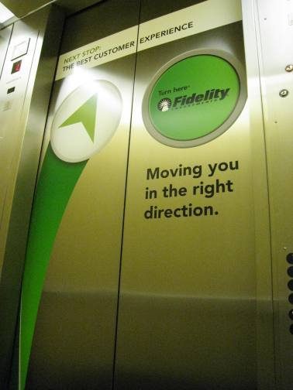
Rational and Conscious
Emotional and Subconscious

Slide 51

Why is Customer Experience important? Both B2B and B2C results by using Beyond Philosophy
Global Container Shipping Company
  Increased Net Promoter Score by 40% in 18m
  Increased volume by 1% for every 4% improvement in the NPS
Construction company – Business to Business
  Increased profits by 50%
  Moved from 4th to 1st in market share
Electrical Retailer
  Reduction in complaints by 20%
  Increase levels of trust by 10%
  3% increase in ‘like for like’ sales.
Middle East Telecom
  Increased market share from 32% to 42%
  Improved operating margin by 7%

Slide 52
EBIDTA- ROI - ROE- PBT
Customer Experience Drives Financial Performance to a Great Extent
CSAT-NPS - CES - ES

Slide 53
Rational and Conscious
For Individual = Character is destiny
For Company = Culture is destiny
Sunil C. Gandhi - India Associate
+91-9869051030 -sg@sunilgandhi.com
Emotional and Subconscious

